Slide 1
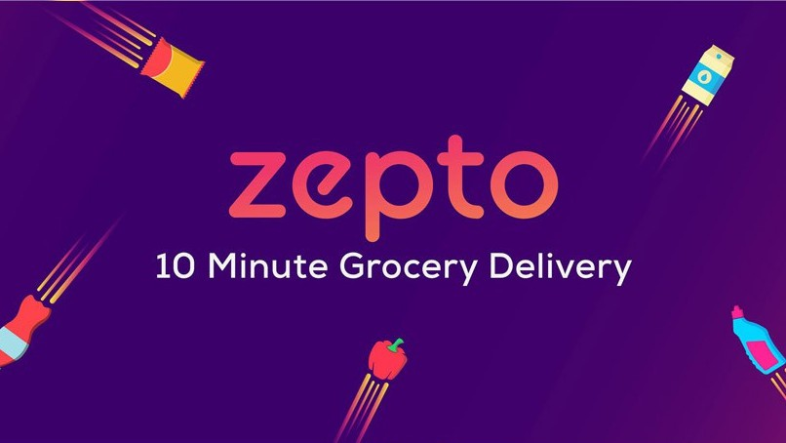
By: Harshit Modi

Slide 2
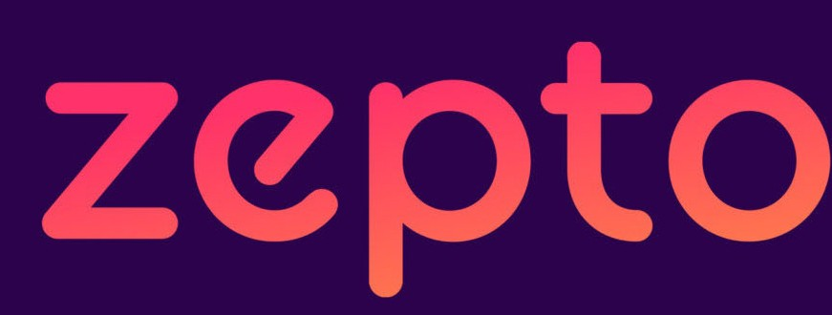

What do?
zepto
Zepto is your next-door quick commerce app, delivering groceries, personal care, and electronics in just 10 minutes. It is facilitated through 220+ dark stores and a catalogue of 6500+ SKUs to choose from.
Dark Stores
A dark store is essentially distribution centers used for the fulfillment of online orders, just
like mini-warehouses usually located in areas with high demand. They are typically 2,500 - 3,500 sqft large and restricted to a few
employees.

Slide 3


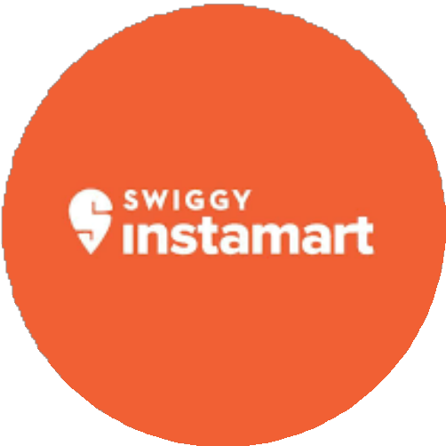
Major Competitors
Market Share
Others 1%
Zepto 23.8%
Swiggy Instamart 31.7%
BigBasket 10.9%
Blinkit 32.7%
~As per June 2023

Slide 4
Key Metrics
Raised a total $560M with a valuation at $1.4B latest valuation. Serves 2.7-2.8 Lakh Orders/Day.
Rs 380 crore sales with Rs 55 crore burn in April 2023.
Median delivery time is 13 minutes which is best among competitors. Dispatches an order within 76 seconds.
220+ dark stores with 1.5% marketing spend. Growing at ~10% MoM (Month-on-month basis).
Provides services in Bengaluru, Mumbai, Delhi, Gurugram, Noida, Ghaziabad, Hyderabad, Chennai, Pune, and Kolkata.

Slide 5
Business Objective
Zepto’s revenue and funding might seem lucrative, but it’s burning money at the rate of ~55 crore Rs every month as of April 2023, with EBITDA margin standing close to -15%.
Since this segment is extremely hard to operate and achieve profitability.
The question arises as to why investors are willing to invest this much money, and what is the business plan behind giving them a successful exit?

Slide 6

Why is it hard to generate profitability?
Low ticket size with Average Order Value = Rs 450 Low margin with Gross Margin = ~15-16%
High last-mile delivery cost = ~Rs 45 per order
Extremely tough supply chain management and operationally difficult to manage

Slide 7
Breaking down unit economics
Number of orders/day = 2.7 lakh Number of dark stores = 220
Number of orders per dark store per day = 2.7 L / 220 = ~1200
Average Order Value = 450 Rs
Gross Margin in this industry = ~16%
Gross Margin at each order = 450 * 16% = Rs 72
Last Mile delivery cost = Rs 45
Gross Margin excluding delivery = Rs 27
Net Profit at each dark store every month = 27*1200*30 = ~ Rs 10 Lakh

Slide 8







Fixed Expenses
These are the expenses they need to inculcate out of those 10 lakhs.
Dark Store Level Rent Maintenance Salaries of staff Wastage
Corporate Level Marketing Software Salaries Expansion

Slide 9
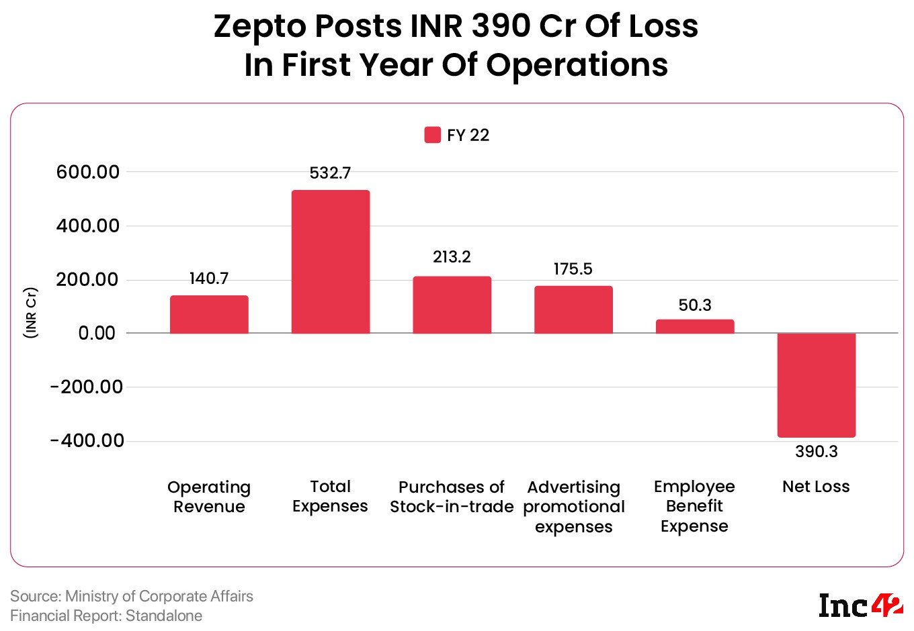
Cash Burn Era
Zepto posted INR 390 Cr of loss in the first year of operations (FY-22) which was from July 2021 - March 2022.
An estimate of loss of INR 900-1000 Cr is predicted in FY23.
As of now, they are burning ~55-60 Cr every month.
This has been possible because of raising ~$560M in last 3 years.

Slide 10
Road to Profitability
Quick grocery delivery segment is expected to grow at ~50% CAGR for the next 4 years which they can leverage out.
Each dark store is cashflow positive i.e., they are profitable at each store level, but not at the institutional level.
Higher number of dark stores signifies overall higher profit which can bring out profitability for the whole institution.
0.3% population of India uses Zepto. Profitability can be achieved when this number reaches 0.35%.

Slide 11
Road to Profitability
Sell premium goods with higher margins. The acquired user base can be used to upsell these goods.
Introducing electronics was a good proposition as they are high gross margin products.
Zepto earns 10-12 crores/month by promoting brands present in its catalogue. Increasing this number can significantly increase profit.
There is ample untapped potential in cities like Chandigarh, Ahmedabad, Jaipur, Goa, Lucknow, Indore etc., in which they can tap into.

Slide 12
SWOT Analysis
Strength
Limited Inventory: They keep very limited inventory in dark stores according to customer purchase behaviour using big data analytics.
Strong financial support: Zepto is well-funded with total capital raised over $560M. It gives them freehand to expand and grow.
Solid supply chain management which they applied using Six Sigma principles.
Weakness
Quality Control Check: During rapid expansion, it can become pretty difficult to do quality control checks on dark stores.
Strolling Indian Consumers: They are not loyal and look for better cost, services. One mistake can cost them a huge consumer base.
Small ticket size: With an AOV of ~450 Rs, it is not very efficient.

Slide 13
SWOT Analysis
Opportunity
Threat
The organized grocery business is just 5-8% of the overall grocery market in India, which can be tapped into.
Entering fresh locations: They can infiltrate into existing locations and enter new cities.
Brand Utilization: Zepto has developed a brand identity, which they can utilize to enter new sectors.
Price War: Hyper-competitive market due to price/coupon wars between platforms.
Danger from huge players: Dmart, and Reliance Retail like players whose businesses are worth
$5-6B every year, can themselves come into this industry and finish them up.

Slide 14
Summary
Since its inception in July 2021, Zepto has grown to become one of India’s most valuable and promising startups. It has built a strong workforce, leadership, solid funding, and figured out a pretty robust execution plan maintaining operational excellence and supply chain management.
In the past few quarters, it has reduced its losses to a certain extent, but there’s a long journey ahead.
In order to reach profitability, certain proposed solutions can work out while adhering to basic principles and finding methods to reduce their operational expenses.

Slide 15


By: Harshit Modi

